Slide 1
Network Optimization
Generalizability -- Create a single network capable of accurately analyzing semi-diverse datasets
Pose estimation accuracy
Many possible issues due to human error
Notes:
Once config edited, labeling process can begin
Reiterate goals of the network; generalizability and accuracy
In prior trainings we have come across issues that can be mitigated by taking a few major pointers into consideration
I want to share to make your life easier

Slide 2
1. Consistency
Objects must be labeled in same location every time
Issue: inconsistent labeling leads to “erratic” labels.
More likely that the network will misidentify an object
Prevents accurate analysis
Notes:
As you could guess…

Slide 3
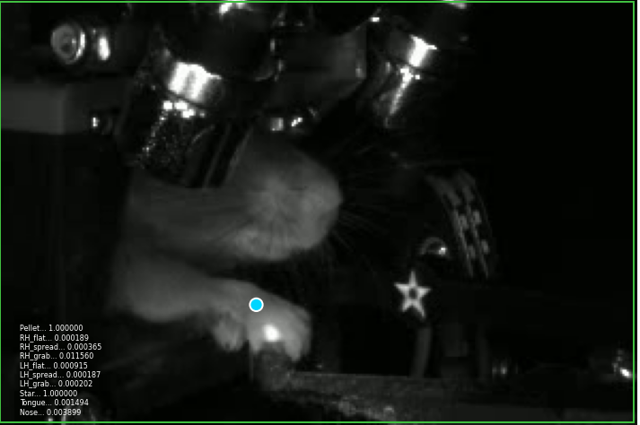
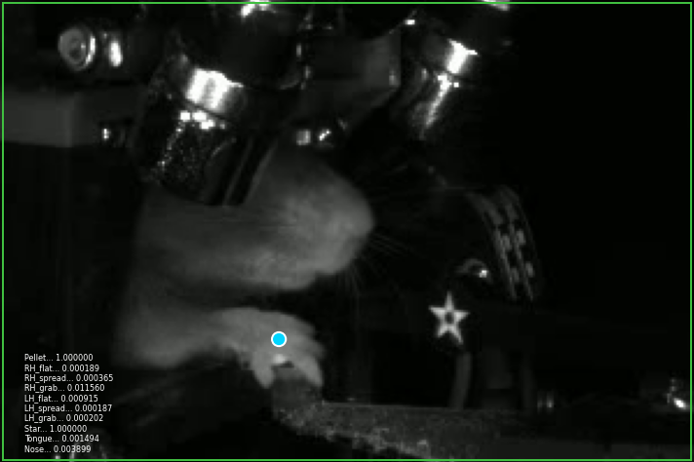

Slide 4
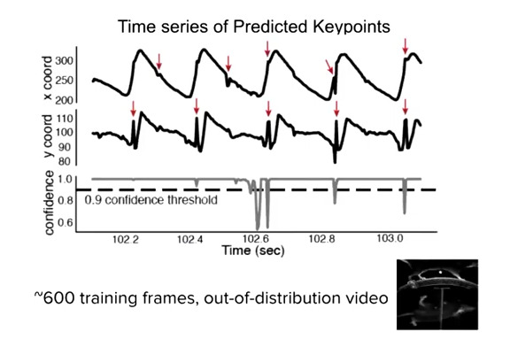
Notes:
Wanted to show videos demonstrating the effects of filtering; this graphic shows the same effect.
Also shows what may occur if labels are inconsistent.
Consistent trajectory – blips denoted by arrows indicate that the network has mislabeled the object at that timepoint
Can also see confidence dips aligning with these events – indicate an underperforming network

Slide 5
2. Diversity
Sampling should encompass variations existing in the dataset
Lighting changes
Unique behaviors
Different subjects
Experimental setups*
Time range*
Issue: lack of dataset diversity leads to poor generalizability
Network unusable for analyzing other datasets
Notes:
If a variation exists, address it by labeling instances of the variation
Last two have asterisks because they can apply sometimes (will mention more about setups on the next slide)

Slide 6
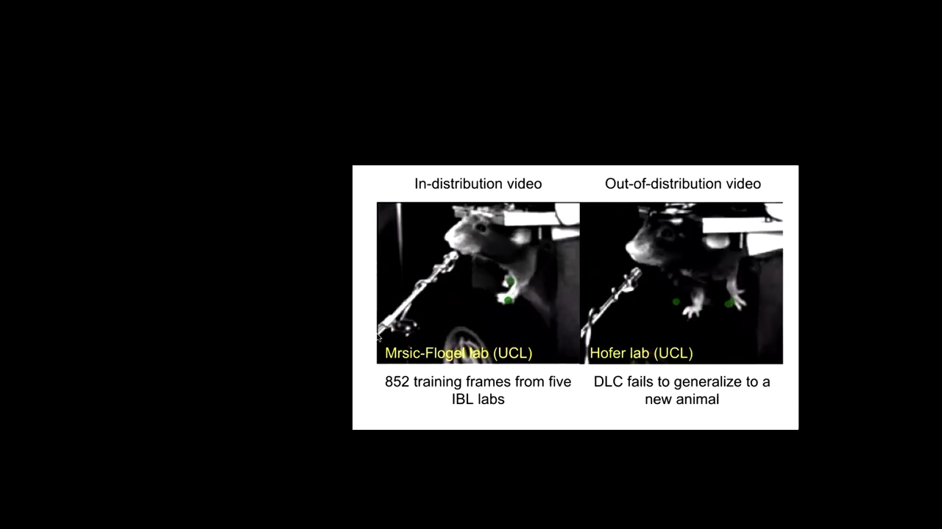

Slide 7
3. Comprehensive Labeling
If a label is created for any video frame, all visible objects must be labeled on that frame.
Side and Front are separate
Issue: computer interprets a missing label on a visible object as if the object is not present.
Contradicts prior labels – WILL impact network training
Notes:
LAST: similar effect to lack of consistency; likely that labels will bounce around erratically or an object in view wont be labeled at all (similar behavior) to graphic shown under consistency)

Slide 8
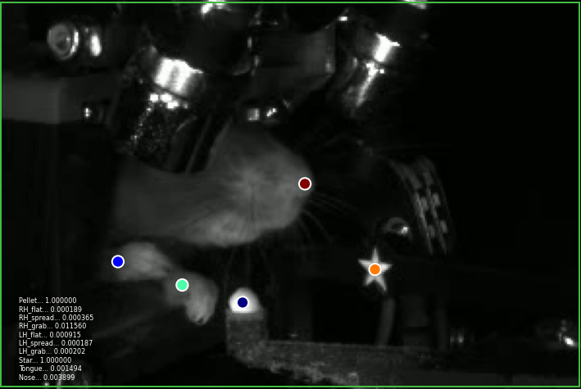
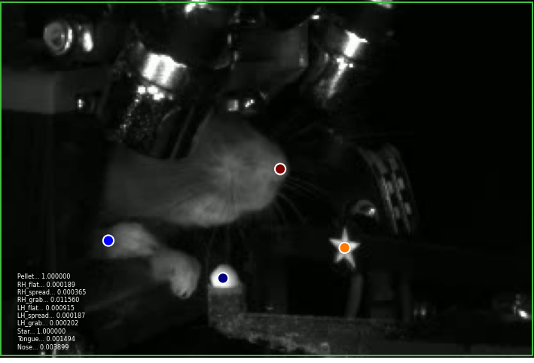

Slide 9
4. Focus on Behavioral Epochs
Identify desired outcomes of the trained network
Which behaviors need to be tracked correctly?
What data is needed for subsequent analysis?
For reach finding, we need the initiation, peaks, and end of a reach, along with the outcome of each reach.
Necessary for logical tests in analysis
Label these epochs more frequently than other behaviors

Slide 10
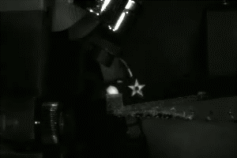

Slide 11
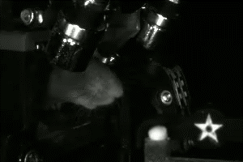

Slide 12
5. Handling Complex Body Parts
If an object/body part regularly shifts orientation, multiple labels may be necessary.
Unique label for each orientation.
Ex. RH_Flat, RH_Spread, RH_Grab

Slide 13
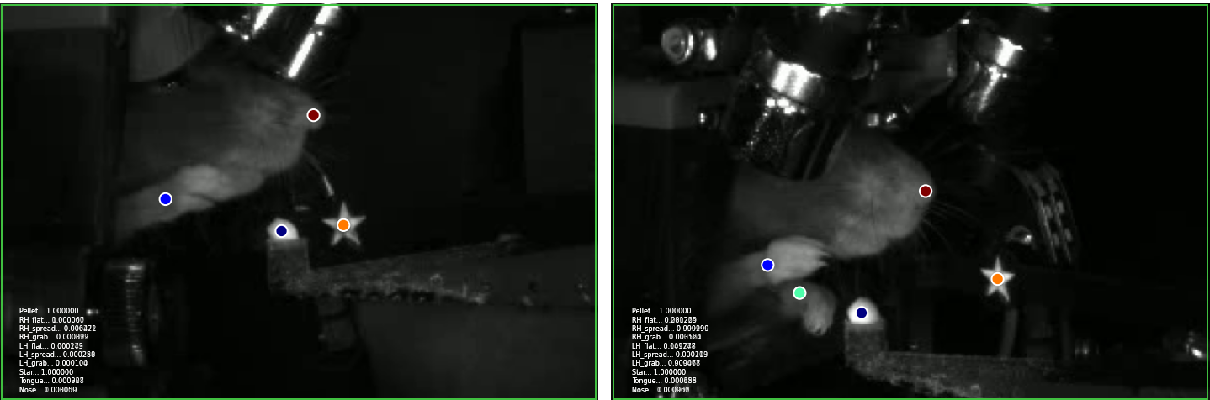
Right Hand Flat

Slide 14
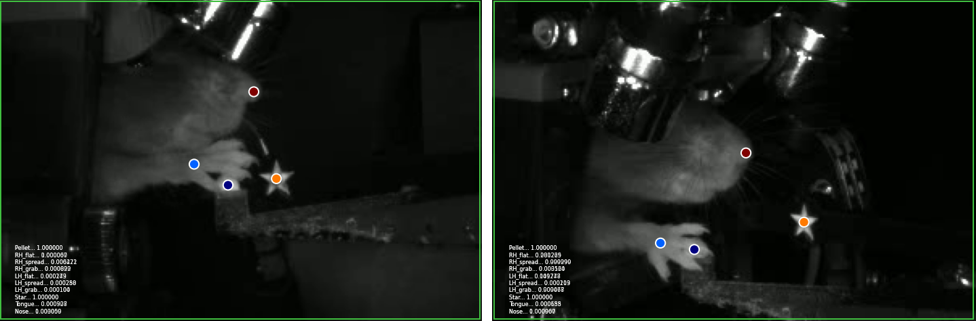
Right Hand Spread

Slide 15
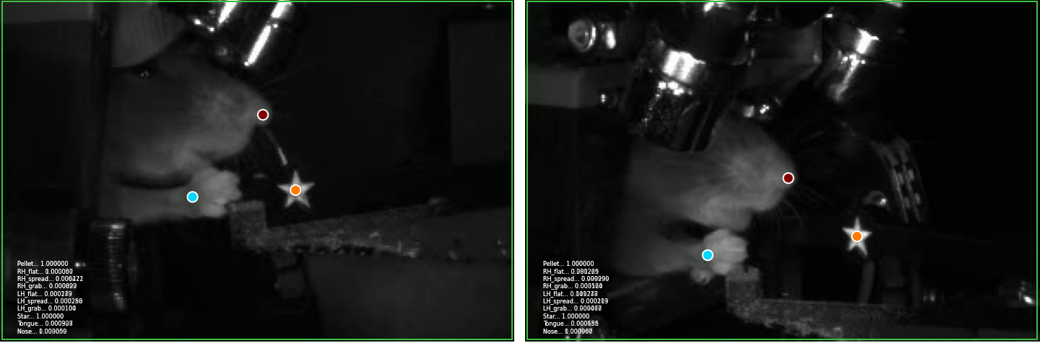
Right Hand Grab

Slide 16
Ensuring Accurate Trained Networks
Iterative process
Train
Analyze
Evaluate
Notes:
After all labeling is complete; time to train the network; simply press the train button on the explorer GUI
Goal of this slide is simply to show that the refinement of a network is an iterative process. – context shown on next slide

